Slide 1

Graph Analytics - An Introduction
Aditya Bagchi
Emeritus Professor
Computer Science Dept.
School of Mathematical Sciences
Ramakrishna Mission Vivekananda University, Belur, WB

Slide 2

Graph studies mainly involve four different areas :
Graph Drawing: Construction of graphs from events and evidences. Graph drawing is the oldest of the four areas (1970). It involves development of computational techniques and algorithms to automatically lay out (draw) graphs. Results generated by the graph-drawing community have become the R&D foundation of the other three areas.
Graph visualization is a subarea of information visualization (1990). Graph visualization differs from graph drawing as it involves human intervention in visually and interactively exploring graphs. Graph visualization almost always involves some graph-drawing technique as part of the exploration process.

Slide 3
Though the term “graph mining” appeared around early 2000, data mining community has studied graph mining since the mid-1990s. It employs computation to identify graphs’ structural features and their interrelationships usually avoiding human intervention in the exploration process.
Analytics cover the discovery of meaningful patterns or interesting insights from data using: Mathematical properties of data, Computation to access and manipulate data, Domain knowledge to increase interpretability of data and results, Statistical techniques for drawing inferences or making predictions on data. It involves information retrieval, data management, human-computer interaction, computer graphics, visualization and definitely Graph Theory.

Slide 4
Three broad purposes of Analytics:
Using observed or measured data from a real-life problem situation.
Uncover the characteristics of a data set based on its mathematical properties.
Answer specific questions from one or more data sets with a given level of certainty.
Develop a mathematical model for predicting the characteristics or behavior of yet unobserved data from the same situation

Slide 5
Application Areas:
Electric Power Grid Analytics:
Power Grids control the electrical power from generators to consumers.
Power Grids facilitate the sharing of resources and infrastructures across different generating stations.
Continuous supports needed for day-to-day operations ranging from planning to maintenance to failure recovery as well as proactive detection of grid vulnerabilities and signs of potential crises.
A power grid visualization typically refers to an overlay of a network of buses (nodes) on top of a geographic map, with different colors and icons. Icons display multivariate information.
“Green Grid” is a popular power grid analytics package.

Slide 6
Vehicular Traffic Control:
Mapping of vehicular traffic over road network.
Control traffic flow with dynamic change in traffic.
Decision against traffic blockage.
Expectation of problems and proactive actions.
Tourism Management:
Tour Planning against different constraints (Constraint Satisfaction Problem).
Mapping of tour plan against air, rail and road network.
Management of tourist traffic.
Social Network Analytics:
Representation of Social Network as a Graph.
Storage & Retrieval of Graph data and to design a suitable graph data model.
Finding Communities and other patterns.

Slide 7
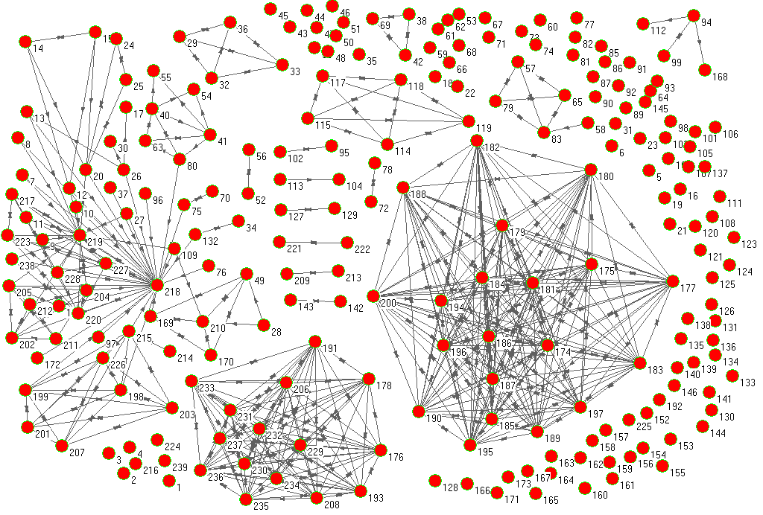
Social Network Data Model:

Slide 8
Network Features:
Generates a collection of isolated Sub-graphs
There can be isolated nodes
Two nodes may be connected by One-way Ties [Originates at .. & Terminates at.. - Asymmetric Ties]
Two nodes may be connected by Two-way Ties [Symmetric Ties : Reciprocal Relations]
Edges may be of different types & there may be multiple edges between two nodes [Multi-Graph]

Slide 9
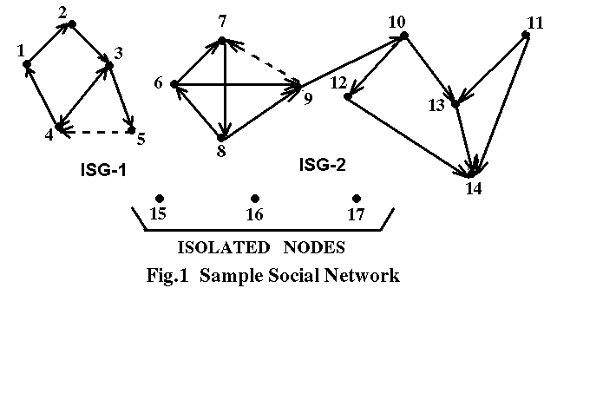

Slide 10
Properties of Social Network:
Community formation – Communities in Web are connected to or isolated from each other. Members of communities share some common features.
Evolving – Social Network evolves or reshapes its structure over time. Evolution reflects the changes in social structures.
Small World Effect – Social networks exhibit small world behavior as average connected distance among nodes is low.
Fractal nature – Sub-graphs in a Social Network have structural similarities with the original Social Network.
Graph needs pre-processing and compression.

Slide 12
Hyper-structures:
Formal Definitions :
Hyper-node: In a nested-cycle structure, the largest or the outermost cycle is defined as a hyper-node. For a graph G(V,E), if there exists a nested cycle structure with a set of cycles such that, {C₁ ⊇ C₂ ⊇ …. ⊇ C_{n})} where C_{i} is a cycle in G, then C₁ is the hyper-node corresponding to the nested cycle structure. So, a hyper-node represents a SCC.
Homogeneous Hyper-node: In a homogeneous hyper-node all the edges are of same type.
Heterogeneous Hyper-node: In a heterogeneous hyper-node all the edge-types need not be same.

Slide 13
Hyper-edge: If any node p outside a hyper-node H is connected to more than one node belonging to H with same edge-type and in the same direction, all such edges will be fused to only one edge as a hyper-edge. This hyper-edge will now connect p to H. A hyper-edge may connect a hyper-node with a node or another hyper-node.

Slide 15
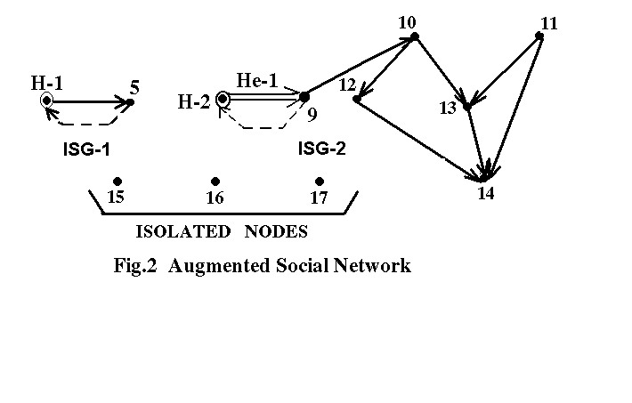
H-1 and H-2 are Homogeneous Hyper-nodes.
He-1 is a Hyper-edge.
Hyper-Structure Compression

Slide 16
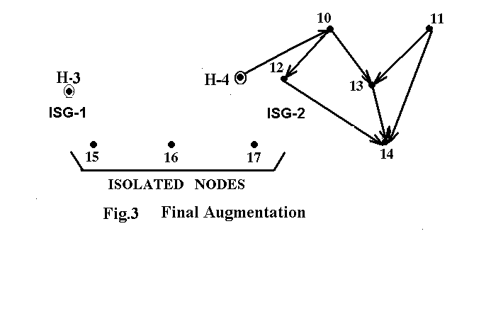
H-3 and H-4 are Heterogeneous Hyper-nodes.

Slide 17
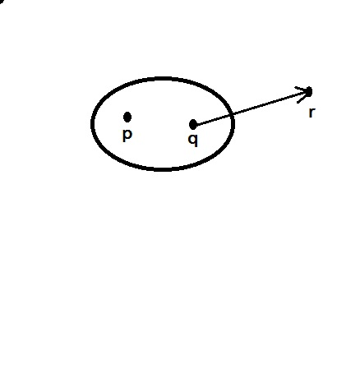
Lemma 1: Hyper-node and hyper-edge based compression turns a digraph to a DAG.
Lemma 2: Conversion to DAG from original digraph is connectivity invariant.
Hyper-Node
If the hyper-node has N nodes, number of possible paths from node p to node r can be (N-1)!
If fused, there will be only one path.
Notes:
ss

Slide 18
Mitra S., Bagchi A. & Bandyopadhyay, A.K. “Design of a Data Model for Social Network Applications,” Journal of Database Management, vol.18, No.4, pp.51-79, Oct.-Dec. 2007.
Social Network Graph:
X is-a-friend-of Y
X created-post Post # n
Y created-comment Comment # m on Post # n
Post # n contains Text
Media
Location

Slide 19
Extending Property Graph Model (Neo4j):
V: set of vertices
• E: set of edges
• TN: set of node types
• f (TN V): type assignment to nodes
• TE: a set of edge types
• g (TE E): type assignment to edges
• AN: set of node attributes
• AE: set of edge attributes
• dom(AN[i]): domain of the i-th node attribute
• dom(AE[i]): domain of the i-th edge attribute
• φ: a set of constraints
– Value constraints
– Structural constraints
– Semantic constraints

Slide 20
Metrics:
Most common relationship is “Friends” – can be used for identifying Communities.
One may belong to more than one communities. Members of one community tend to know each other but members of different communities may not. Effort is not to merge communities but to discover reasons for common membership and differences among communities.
Needs to identify “simrank”: a way to discover similarities among node properties.
Triangle counting to measure the connectedness of a community.
Measurement of neighborhood sizes of nodes..
Computation of Transitive Closure.
Usually isolated subgraphs are not of interest.

Slide 21
A B D E
C G F
Total No. of Possible Edges = ⁷C₂ = 21
Actual No. of Edges = 9
Probability of having an edge between any two nodes = 9/21 = 0.429

Slide 22
Node Affinity:
Neighbours of B: A,C,D
Possible No. of edges = ⁴C₂ = 6, Actual No. = 4
Probability of having another edge among neighbours = 4/6 = 0.67
Neighbours of F: D,G,E
Possible No. of edges = ⁴C₂ = 6, Actual No. = 5
Probability of having another edge among neighbours = 5/6 = 0.83
{F, D, G, E} has higher affinity than {B,A,C,D}

Slide 23
Different types of Social Network:
Telephone Net: Monitoring ph. Calls over a fixed period (say, 1 month). A call between two nodes creates an edge, weighted by the no. of calls made within the specified period.
E-mail Net: An edge, if an e-mail is sent from one node to another or if an e-mail and its reply creates a node (avoids spam). Else strong or weak edges may be created. Similar net can be formed with SMS.
Collaboration Net: Individuals who wrote one or more papers together - Edges may be weighted by the no. of joint publications - Identifies authors working in the same area. Here both Authors and Papers are nodes. So it is a graph of several node types.

Slide 24
Alternative view of the same data where nodes are papers. Two papers connected by an edge only if they have at least one common author.
Helps in forming communities as collection of papers on same topic.
The entire dataset can also be represented as a bipartite graph of two node sets, e.g. Authors and Papers.
Different from citation network.
Similar k-partite graphs can be created. Possible application: Crime and Criminal Tracking.

Slide 25
Clustering:
Communities are those node sets that are connected by many edges: Group of friends, Researchers working in the same area, Persons working in the same organization etc.
A distance measure is needed. Let d(x,y)=0 if there is an edge between node x and node y else 1 (1 and ∞ can also be used) – violates triangle inequality.

Slide 26
A B D E
C G F
Total No. of Possible Edges = ⁷C₂ = 21
Actual No. of Edges = 9
Probability of having an edge between any two nodes = 9/21 = 0.429

Slide 27
Referring to earlier Figure,
(A,B,C) and (D,E,F,G) form two communities.
(D,E,F) and (D,F,G) are two sub-communities, overlapping on two out of three nodes.
No standard clustering algorithm can identify them.
Hierarchical algorithm tends to start with each edge forming 2-member clusters and gradually grow.
If initially edge is randomly chosen, there is 1/9 probability to start with (B,D) and algorithm will definitely give a wrong result. We need a different method for a large graph.

Slide 28
Trying K-means algo. with k=2.
Randomly choosing two nodes as initial centroid.
Let the chosen nodes be far from each other (say, B,F)
(A,B,C) & (E,F,G) are easily placed but what about D, equally spaced between B and F.
Placement by shortest avg. distance will solve problem here but in large graph there will be more errors.
Needs new method: Betweenness (Girvan-Newman Algo.)
An edge (a,b) has the betweenness value equal to the number of appearances in all the shortest paths between any two nodes x and y.
Higher the value, higher is the chance that a and b are in two different clusters.
For any nodes of {A,B,C} and {D,E,F,G} (B,D) is definitely present.

Slide 29
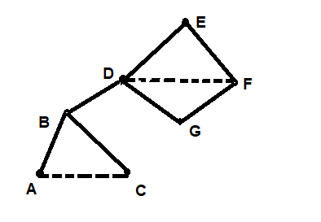
A B D E
C G F
Original Graph
BFS with E as the root
Weight of edges: AB=1, BC=1, BD=3, DG=0.5, FG=0.5, EF=1.5, ED=4.5
Adding contribution of all BFS considering each node as root and dividing it by 2 we get score of BD is 12 and it is highest among all edges. So, nodes B & D should be in two different clusters.

Slide 30
5 12 4.5
5 4.5 4 1.5
1.5
A B D E
C G F
A B D E
C G F

Slide 31
Speeding Up the Betweenness Calculation:
It takes O(ne) running time to compute the betweenness of each edge for a graph of n nodes and e edges.
Complexity is too high for a large graph (e.g. one million nodes)
However, if a subset of the nodes is chosen at random and used as the roots of breadth-first searches and continued this way, an approximation to the betweenness of each edge may be obtained, that may serve well in most applications.

Slide 32
A B D E
C G F
H
Partitioning of Graphs: A proper definition of a “good” cut must balance the size of the cut itself against the difference in the sizes of the sets that the cut creates.
Normalized Cut: First, define the volume of a set S of nodes, denoted Vol (S), to be the number of edges with at least one end in S.

Slide 33
Suppose we partition the nodes of a graph into two
disjoint sets S and T .
Let Cut (S, T ) be the number of edges that connect a node in S to a node in T .
Then the normalized cut value for S and T is
Cut (S, T ) / Vol (S) + Cut(S, T ) / Vol(T )
S = {H} and T = {A,B,C,D,E, F,G}, then Cut (S, T ) = 1. Vol(S) = 1, because there is only one edge connected to H. On the other hand, Vol(T ) = 11, because all the edges have at least one end at a node of T . Thus, the normalized cut for this partition is 1/1 + 1/11 = 1.09.
Now, consider the preferred cut for this graph consisting of the edges (B,D) and (C,G). Then S = {A,B,C,H} and T = {D,E,F,G}. Cut (S, T ) = 2, Vol (S) = 6, and Vol(T ) = 7. The normalized cut for this partition is thus only 2/6 + 2/7 = 0.62.

Slide 34
Counting Triangles or Connectedness of a Community:
Triangle is the minimum size cycle. More is the
number of triangles, higher is the connectedness of a community.
Initial Problem:
A graph has n nodes and m edges are added at random.
Creation of more triangles will improve connectedness of the graph.
No. of triplets = ^{n}C₃ ≈ n³/6
Total no of possible edges bet^{n} any two nodes = ^{n}C₂ ≈ n²/2
Probability of having an edge bet^{n} any two nodes when m edges are added at random = m / ^{n}C₂ ≈ 2m/n²
Probability of any set of 3 nodes forming a triangle = (2m/n²)³ = 8m³ / n⁶
Expected no of triangles = (8m³ / n⁶).(n³/6) = 4/3 (m/n)³

Slide 35
If a graph is a social network with n participants and m pairs of “friends,” expected number of triangles will be much greater than the value for a random graph.
If A and B are friends, and A is also a friend of C, there should be a much greater chance that B and C are also friends.
Thus, counting of triangles helps to measure the extent to which a graph looks like a social network.
Age of a community is related to the density of triangles.
When a group has just formed, people pull in their like-minded friends, but the number of triangles is relatively small.

Slide 36
Triangle Counting Algorithm:
A simple C code:
for each node A {
for each out_edge I of A {
for each out_edge J of A {
B = tail of I;
C = tail of J;
for each out_edge K of C
if tail of K == B {… write answer …}
} } }
For each node A, max. no. of neighbor pairs = ^{(n-1)}C₂
For n nodes, max. no. of neighbor pairs = n.^{(n-1)}C₂ O(n³)

Slide 37
A Fast Algorithm for Single Processor:
A graph of n nodes and m ≥ n edges. All nodes are numbered as 1, 2, . . . , n.
A node is a heavy hitter if its degree is at least √m. A heavy-hitter triangle is a triangle all three of whose nodes are heavy hitters.
Separate algorithms are used to count the heavy-hitter triangles and all other triangles.
Number of heavy-hitter nodes is no more than 2√m, since otherwise the sum of the degrees of the heavy hitter nodes would be more than 2m.

Slide 38
Pre-processing of graph:
Compute the degree of each node. Examine each edge and add 1 to the count of each of its two nodes. Time required is O(m).
Create an index on edges, with the pair of nodes at its ends as the key. An index determines, given two nodes, whether an edge exists between them. A hash table would suffice. It can be constructed in O(m) time, and a query about the existence of an edge can be executed in constant time.
Create another index on nodes, this one with key equal to a single node. Given a node v, one can retrieve the nodes adjacent to v in time proportional to the number of those nodes. Again, a hash table, this time with single nodes as the key should suffice.

Slide 39
Order the nodes as:
First, order nodes by degree.
If v and u have the same degree, order them numerically. That is, v ≺ u if and only if either
(i) The degree of v is less than the degree of u, or
(ii) The degrees of u and v are the same, and v < u.
Heavy-Hitter Triangles:
There are only O(√m) heavy-hitter nodes. Considering all sets of three of these nodes, there are O(m^{3/2}) possible heavy-
hitter triangles. Using index on edges, it is possible to check whether all three edges exist in constant time. So, O(m^{3/2}) time is needed to find all the heavy-hitter triangles.

Slide 40
Other Triangles:
Consider each edge (v1, v2).
If both v1 and v2 are heavy hitters, ignore this edge.
Let one of them, v1 (say) is not a heavy hitter and moreover v1 ≺ v2 and {u1, u2, . . . , uk} be the nodes adjacent to v1. Since k < √m, these nodes can be found using the index on nodes in O(k) time, which is surely O(√m) time.
For each ui, first index can check whether edge (ui, v2) exists in constant time.
Since degree of all nodes have already been counted, degree of ui can be found in constant time.
Count the triangle {v1, v2, ui} if and only if the edge (ui, v2) exists, and v1 ≺ ui. In that way, a triangle is counted only once – when v1 is the node of the triangle that precedes both other nodes of the triangle according to the ≺ ordering.

Slide 41
So, the time to process all the nodes adjacent to v1 is O(√m). Since there are m edges, the total time spent counting other triangles is O(m^{3/2}).
Now, preprocessing takes O(m) time. The time to find heavy-hitter triangles is O(m^{3/2}), and so is the time to find the other triangles.
Thus, the total time of the algorithm is O(m^{3/2}).

Slide 42
How to generate a network (Graph):
A generative model is necessary.
Given some parameters, estimate others and to generate a realistic graph.
Given a set of nodes how communities generate edges.
Community Affiliation Graph Model: (V, C, M, {P_{C}})
P_{A} P_{B}
a b c d e f g h i j k l

Slide 43
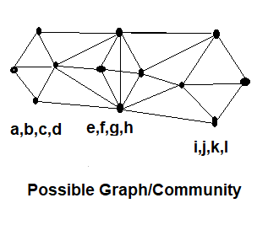
Edge generation in a Community A has a probability P_{A} to connect any two nodes.
Overall edge probability:
P(u,v) = 1 – π( 1 – P_{C})
C ϵ M_{u} ∩ M_{v}
M_{u} set of communities where u is a member.
Higher the value of C, higher will be the edge probability.
If u and v share no community then P(u,v) = ε
It is similar to OR function where u & v has at least one community in common.

Slide 44
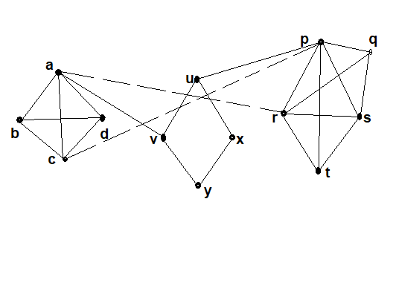

Slide 45
Direct Discovery of Communities:
So far, searched for communities by partitioning all the individuals in a social network. While this approach is relatively efficient, it does have several limitations.
It is not possible to place an individual in two different communities, and everyone is assigned to a community.
It may be possible to create a technique for discovering communities directly by looking for subsets of the nodes that have a relatively large number of edges among them.
Interestingly, the technique for doing this search on a large graph involves finding large frequent itemsets,

Slide 46
Frequent Itemset identification –
TID A B C D Support(A) = 0.7
1 1 1 0 0 Support(B) = 0.6
2 0 0 1 0 Support(C) = 0.5
3 1 1 1 1 Support(D) = 0.5
4 1 0 0 0 Support(AB) = 0.4
5 0 1 0 1 Support(CD) = 0.4
6 1 1 0 0 minsup = 0.3
7 0 1 1 1
8 1 0 1 1
9 1 1 0 0
10 1 0 1 1

Slide 47
Support : Support for a set of items is the % of transactions that contain all of these items.
Let S_{i} = the subset of transactions containing the item i .
Let N_{i} = the no. of occurrences of item i = the no. transactions where the item i has appeared = | S_{i} |
Support for i = (N_{i} / T)*100
where, T =Total no. of transactions.
Similarly, Support for itemset {A,B} = (N_{{A, B}} / T)*100
where N_{{A, B}} = | S_{A} ∩ S_{B} |
So, support for itemset {A,B} is its joint probability of appearance P(AB). For mining rules, support for an itemset must cross a pre-defined threshold called minsup.
Ms’ = Ms * (k/k+1)

Slide 48
Possibility of Community Formation:
Available Facebook data for a member:
Total No. of Friends.
Between two members:
No. of mutual Friends.
Between two members A & B let the Net Management generates the Friendship request. HOW ?
T_{A} = Total No. of Friends of A.
T_{B} = Total No. of Friends of B.
M_{{A,B}} = No. of mutual Friends between A & B.
S_{A} = Support from A = M_{{A,B}} / T_{A}
S_{B} = Support from B = M_{{A,B}} / T_{B}
Both S_{A} & S_{B} may not cross the min-sup threshold simultaneously.
May be a rather crude method, but can help in identifying cliques or SCCs/WCCs.

Slide 49
Use of Jaccard Index provides a better measure:
Distance between A & B = T_{A} ∩ T_{B} / T_{A} ∪ T_{B}
= M_{{A,B}} / T_{A} ∪ T_{B}
Togetherness (AB) = 4/8 = 0.5
Togetherness (CD) = 4/6 = 0.67
CD has more affinity than AB.
Sukomal Pal & Aditya Bagchi, “Association against Dissociation: some pragmatic considerations for Frequent Itemset generation under Fixed and Variable Thresholds,” ACM-SIGKDD Explorations, vol.7, Issue 2, pp.151-159, Dec. 2005.

Slide 50
References:
P.C.Wong et.al., “Graph Analytics-Lessons Learned and Challenges Ahead”, Tutorial, IEEE Computer Graphics & Applications, Sept-Oct, 2011, pp.18-29.
A Rajaraman, J.Leskovec & J.D.Ullman, "Mining of Massive Datasets“, Available from the website of Stanford University.
Thank You

